Slide 1

Punit’s Portfolio Presentation Agenda
Overview/Sitemap (1 min)
Website and its Features (1 min)
Components Used (1 min)
Wireframes/Mockups (2 min)
Design Process and Decisions (2 min)
Development/Build Process (1 min)

Slide 2
Site Map
Home page /index.html
#Portfolio
#Blog
#About me
Contact
/contact.html
Blog page
/blog.html
Portfolio page
/portfolio.html
About
/about.html
#Web Design
#Game Design
#Scripts
#Resume
Resume page
/resume.html

Slide 3
Site Map
Home page /index.html
Contact
/contact.html
Blog page
/blog.html
Portfolio page
/portfolio.html
About
/about.html
Resume page
/resume.html

Slide 4

Work-in-Progress Portfolio
https://punitdh.github.io/
Notes:
Now this is still a Work-in-progress so I’m just going to go over

Slide 5
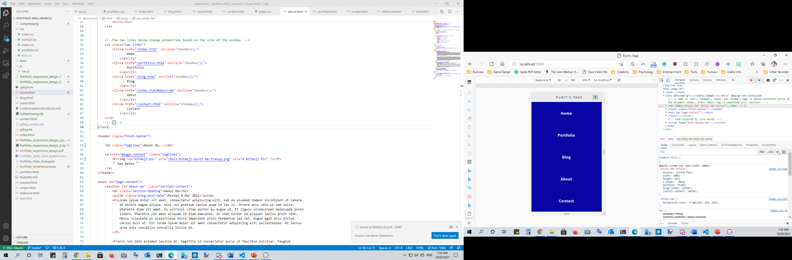
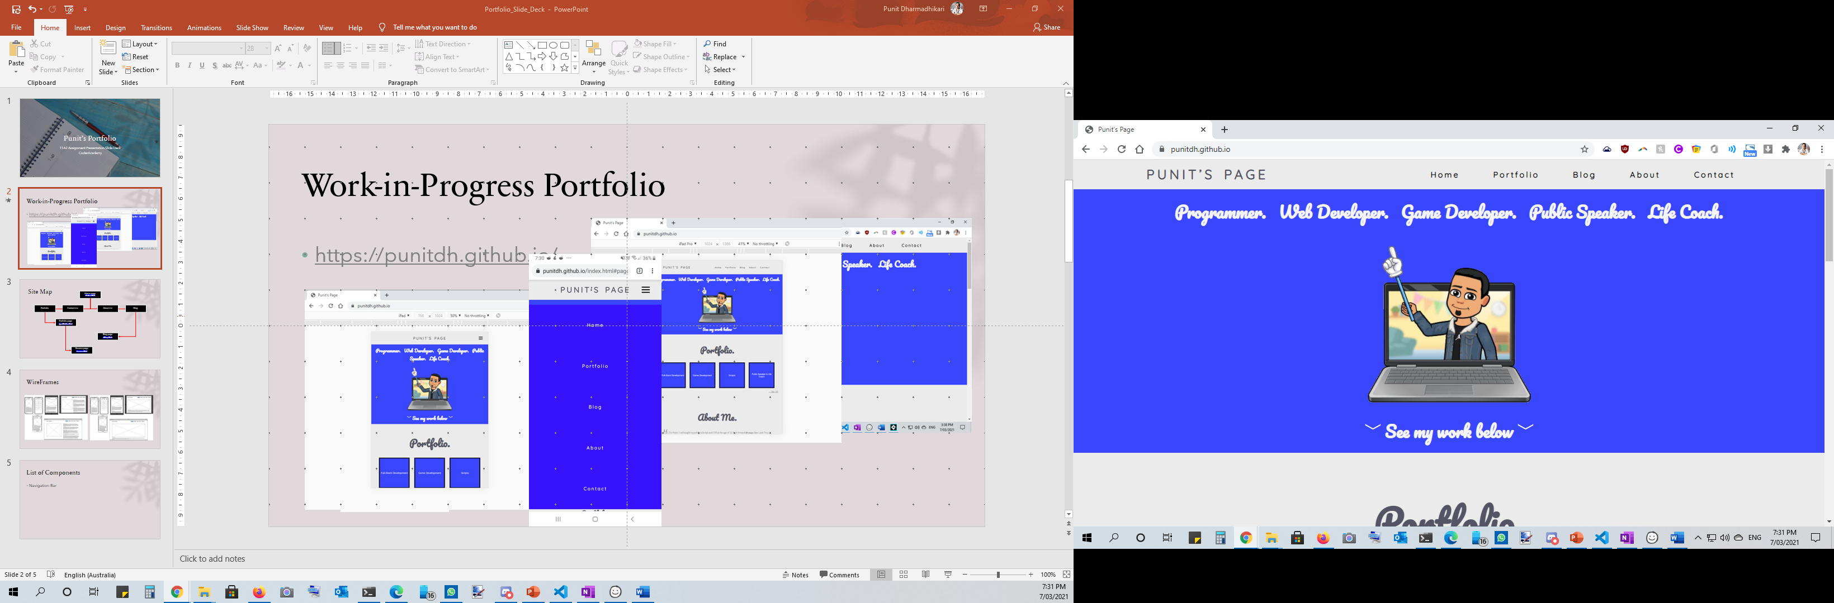
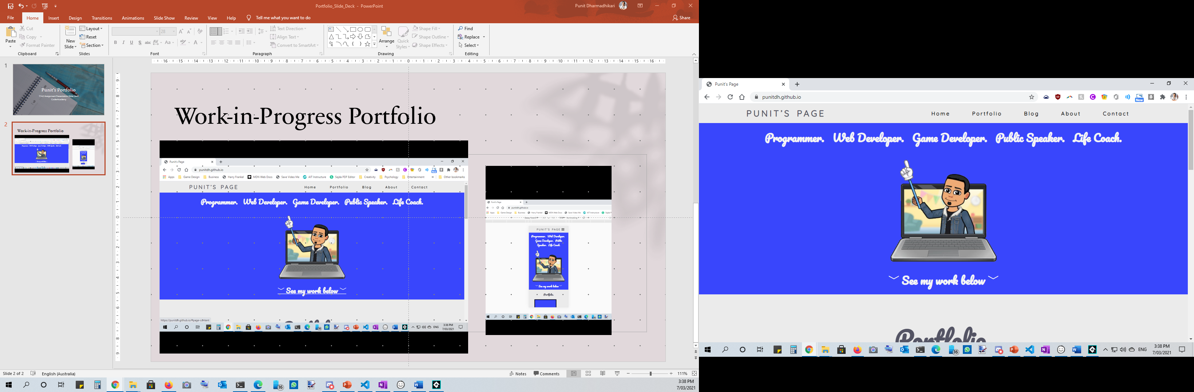
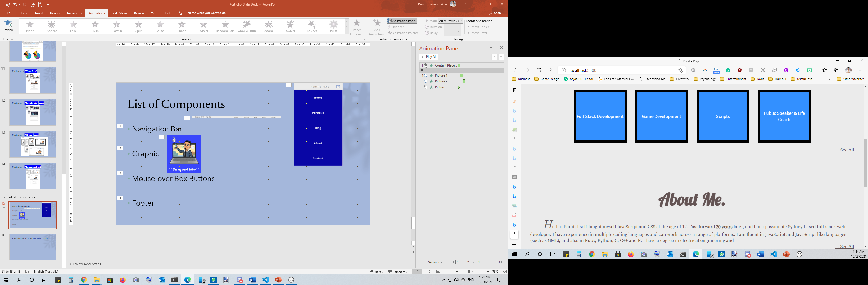
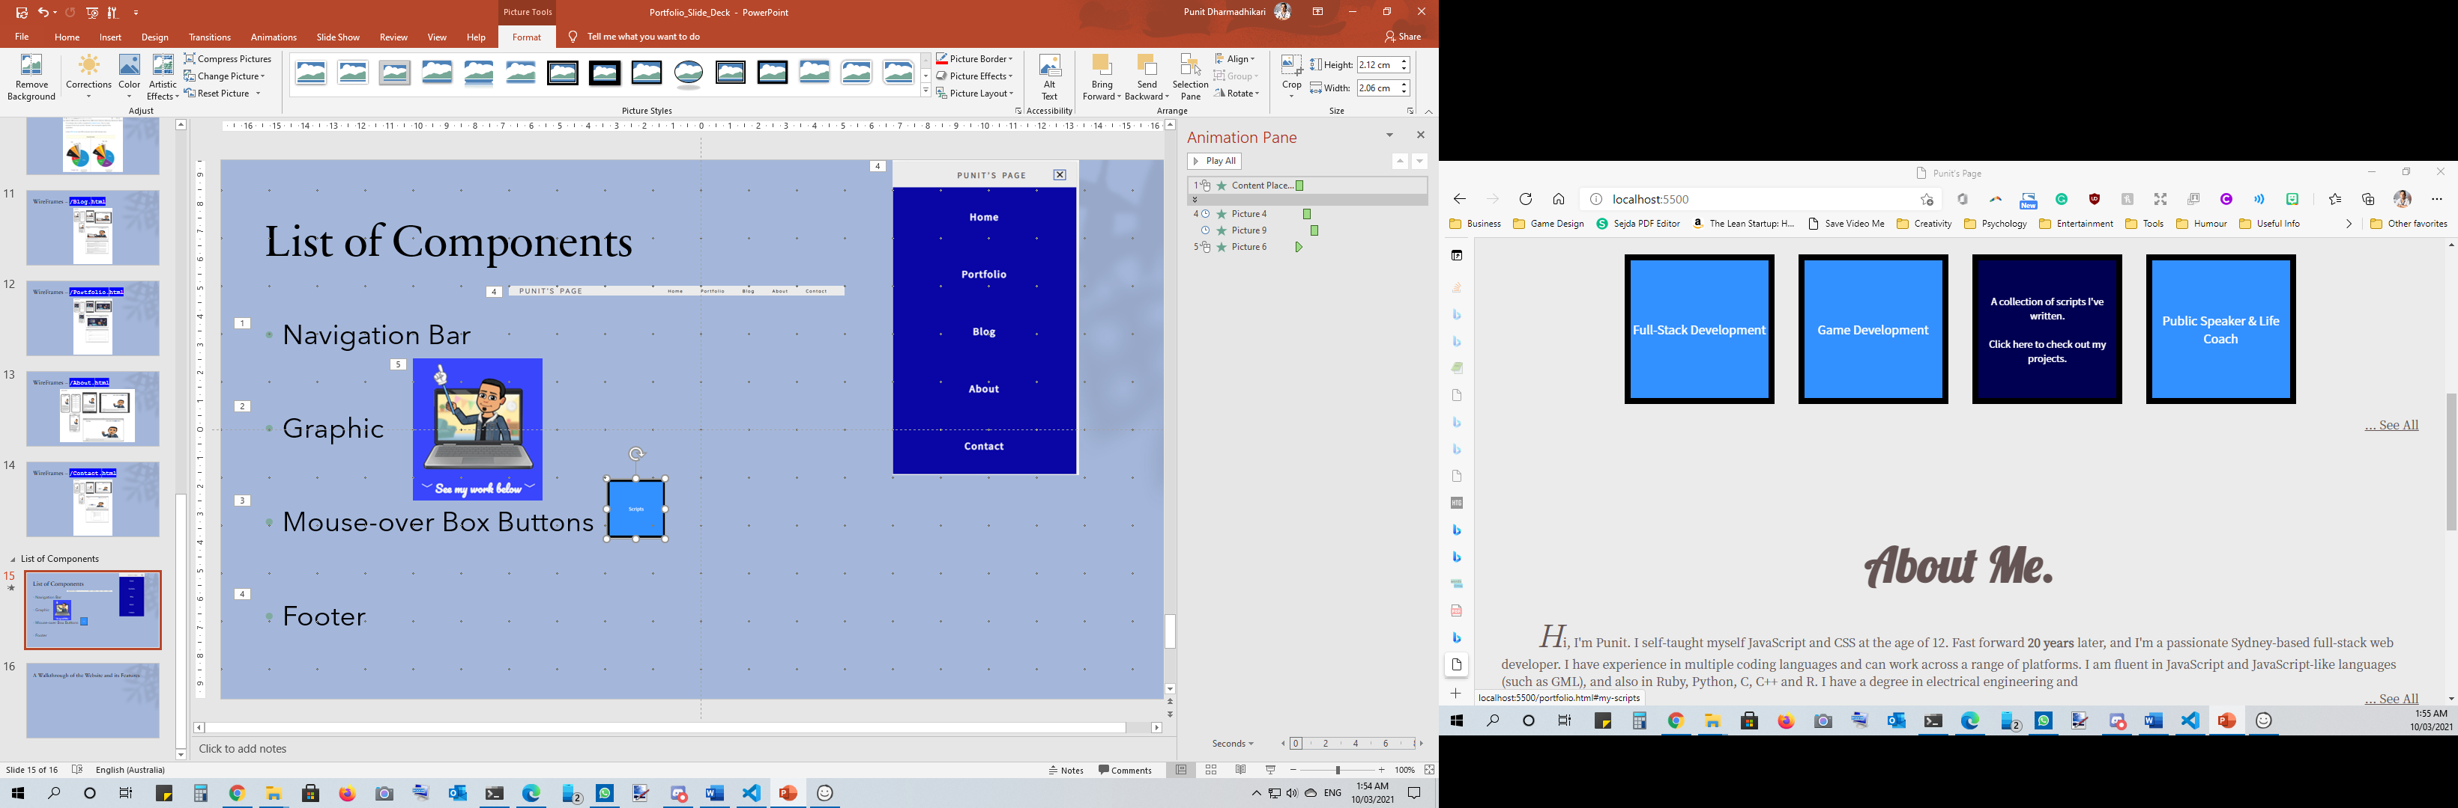
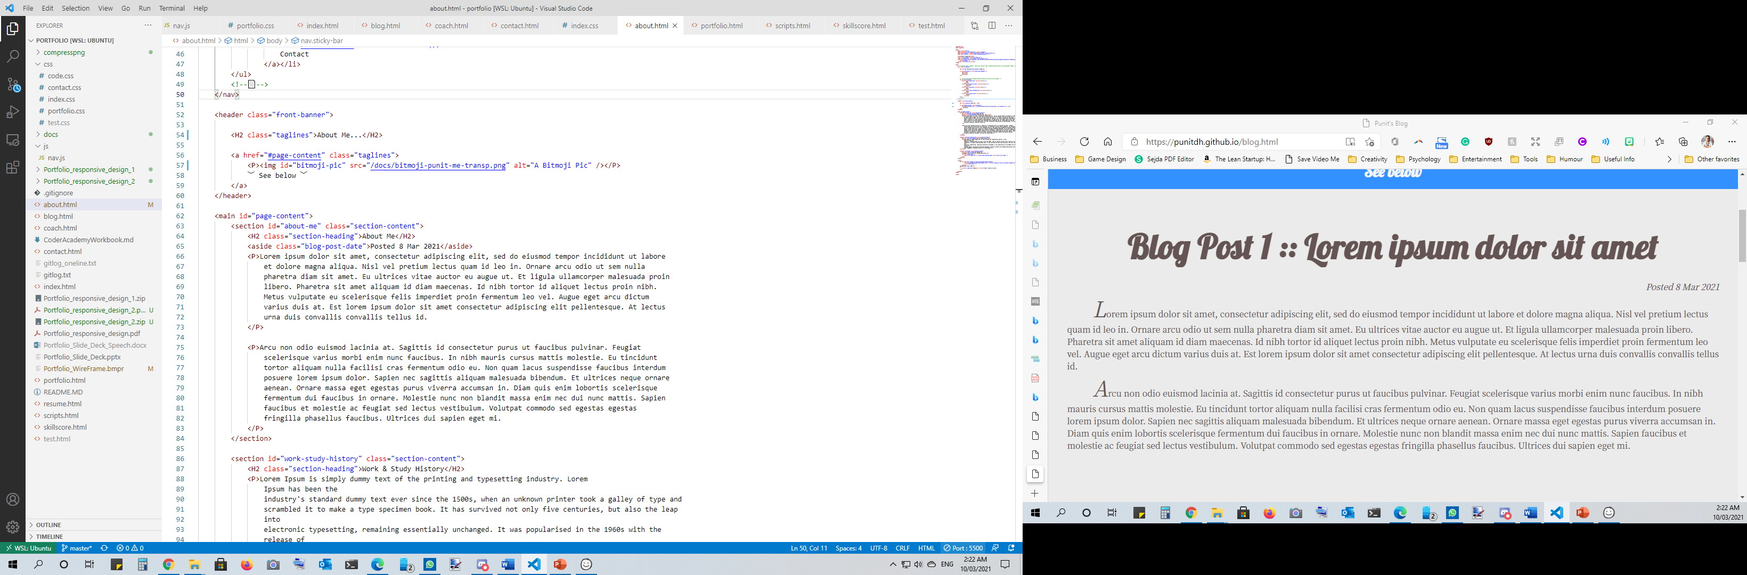
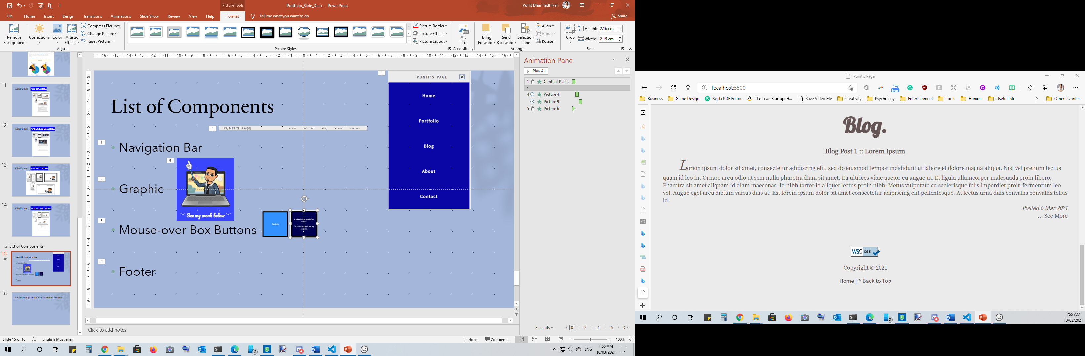
List of Components
Navigation Bar
Graphic
Content
Mouse-over Box Buttons
Footer

Slide 6
HTML Tags
<HTML>
<HEAD>
<BODY>
</BODY>
</HEAD>
</HTML>
<NAV> <!—Navigation Bar--></NAV>
<HEADER> <!—Banner and Graphics--> </HEADER>
<MAIN> <!—Page Content-->
</MAIN>
<SECTION> </SECTION>
<SECTION> </SECTION>
<FOOTER> <!—Footer--> </FOOTER>

Slide 7
Design Decisions
WireFrames

Slide 8
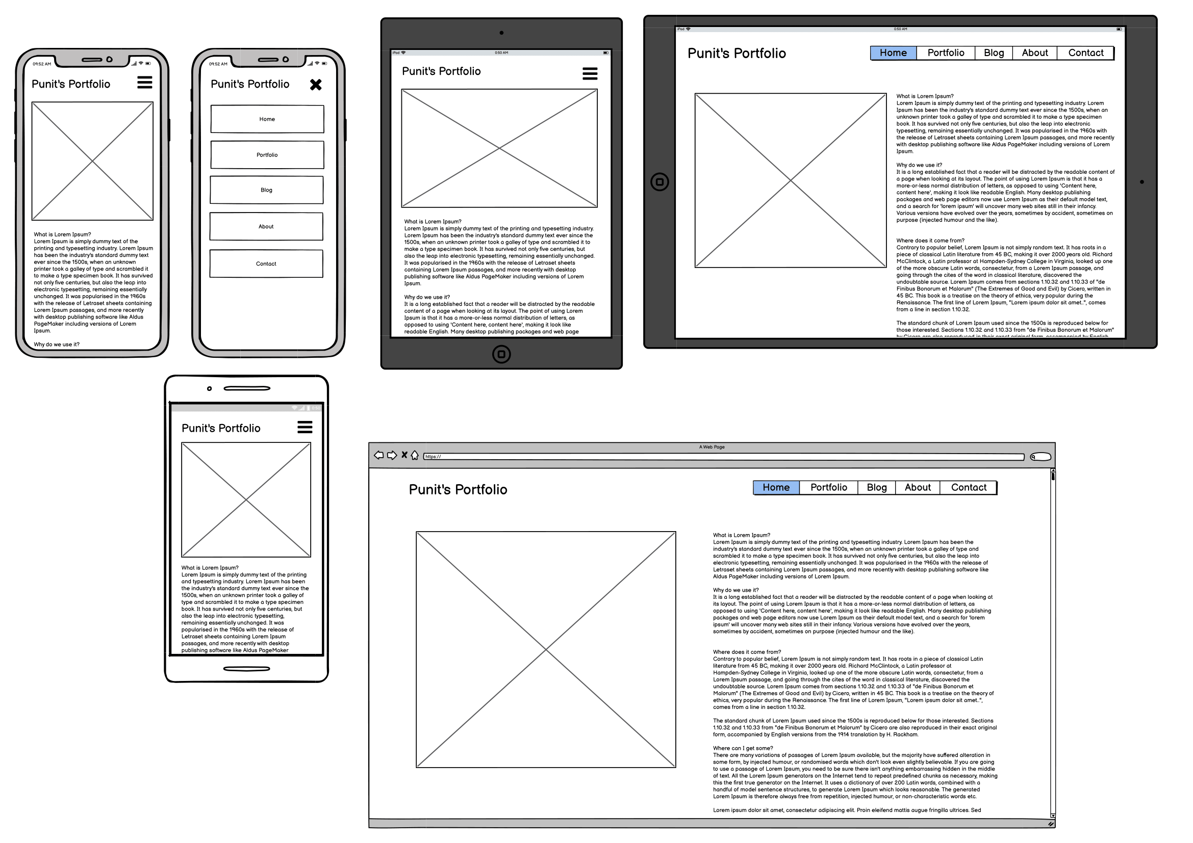
WireFrames – /Index.html

Slide 9
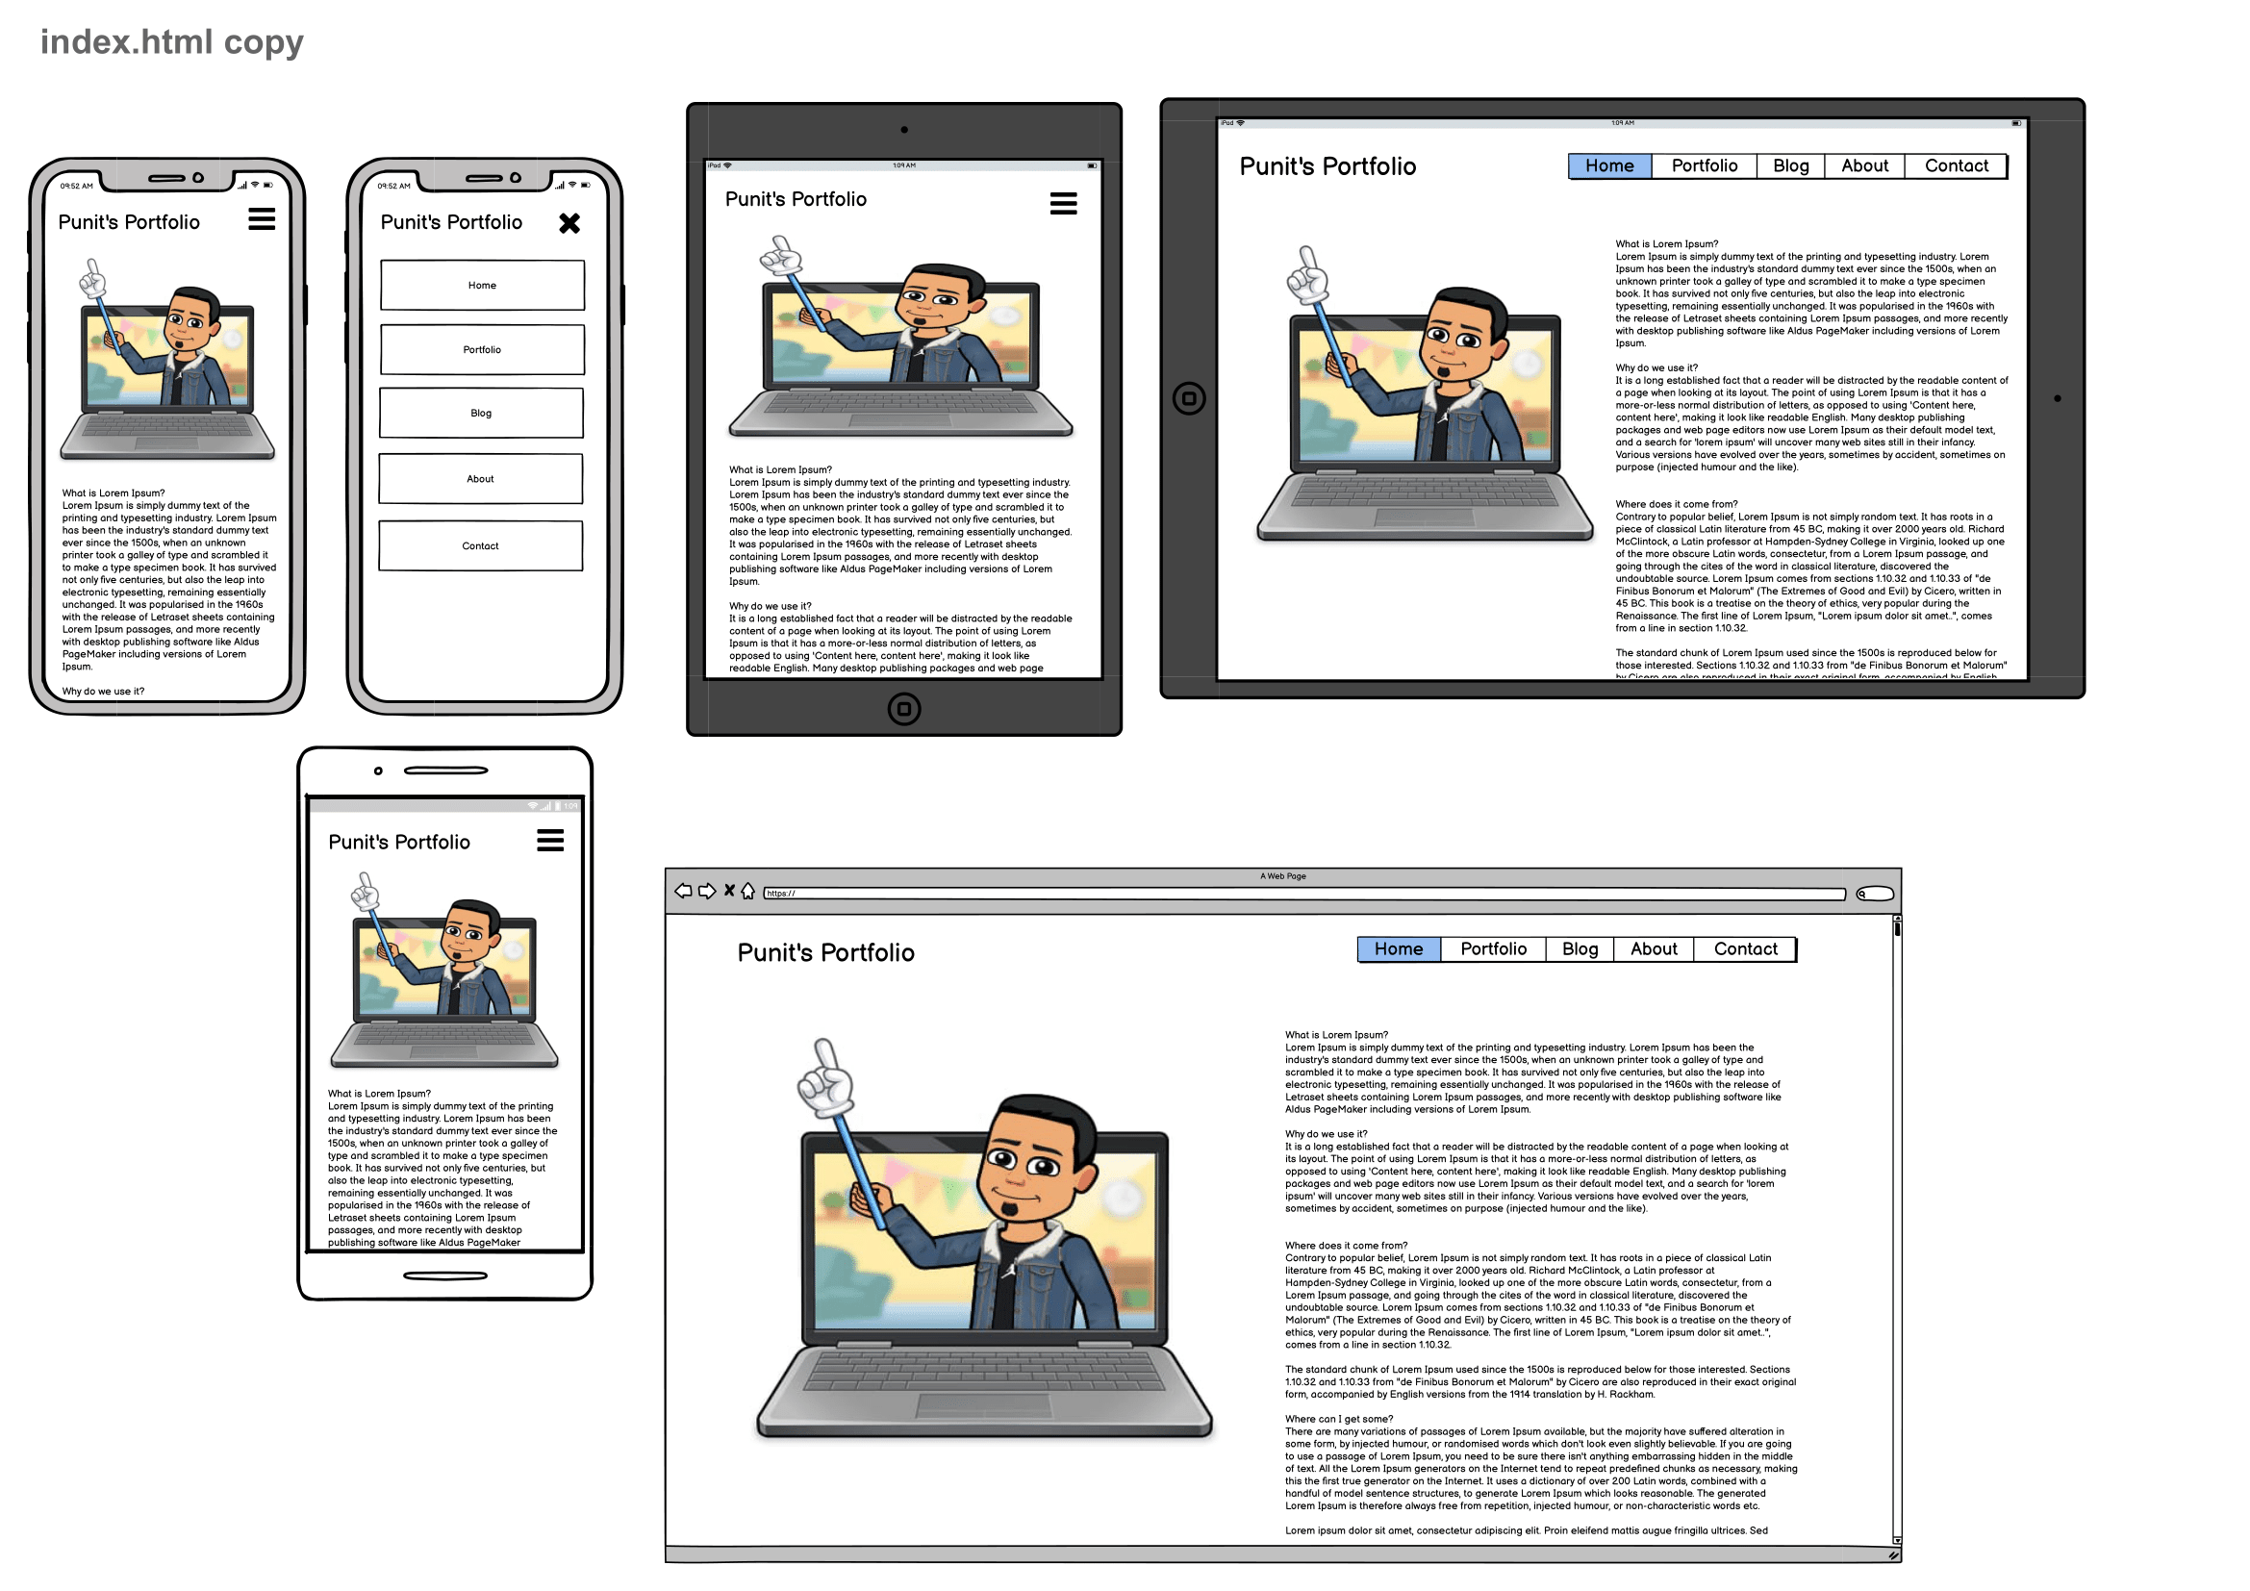
WireFrames – /Index.html

Slide 10
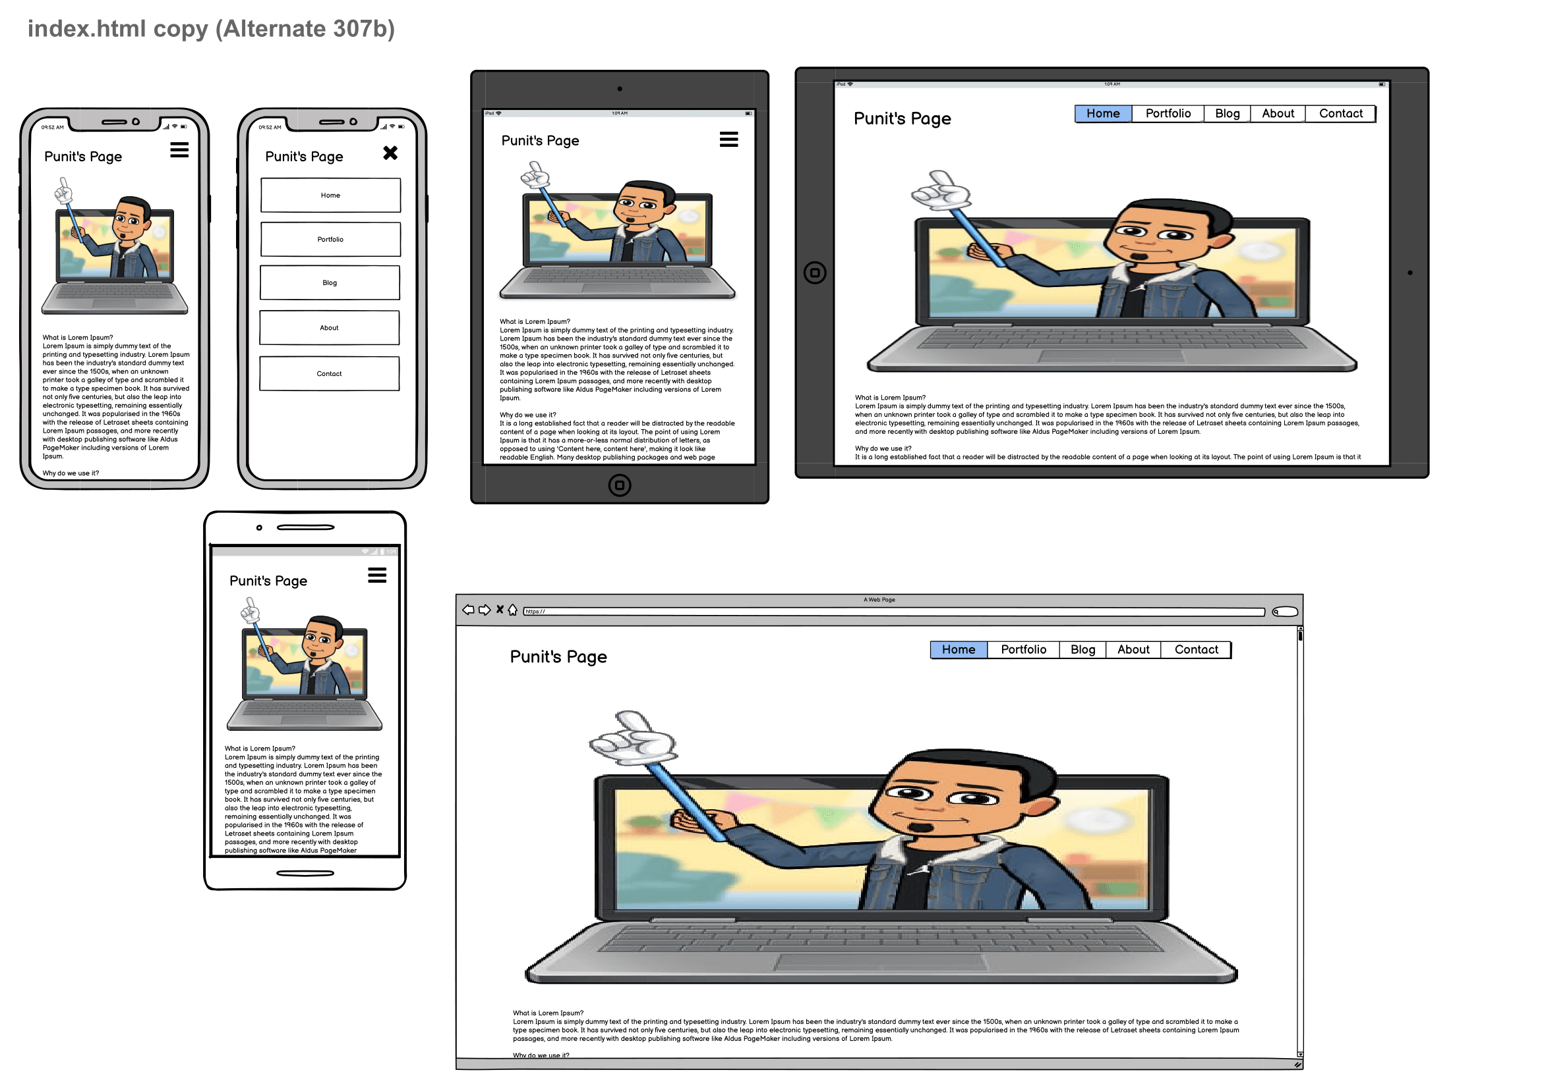
WireFrames – /Index.html

Slide 11
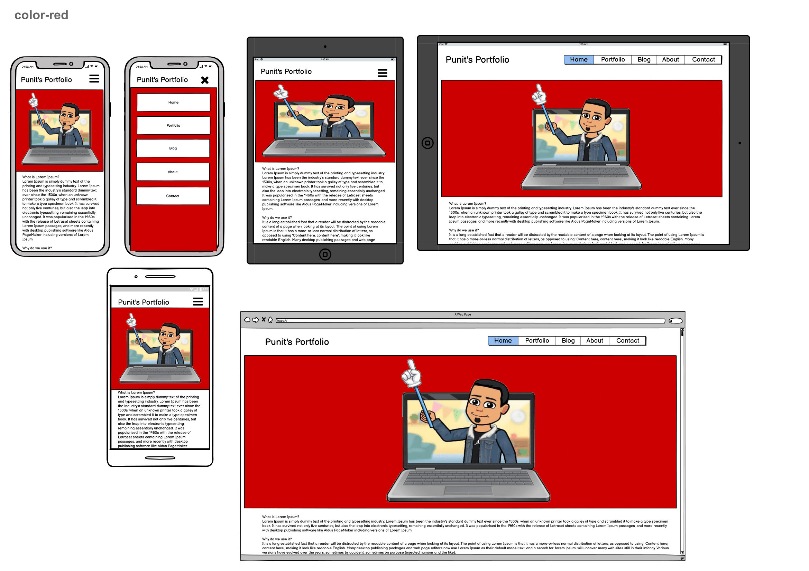
WireFrames – /Index.html

Slide 12
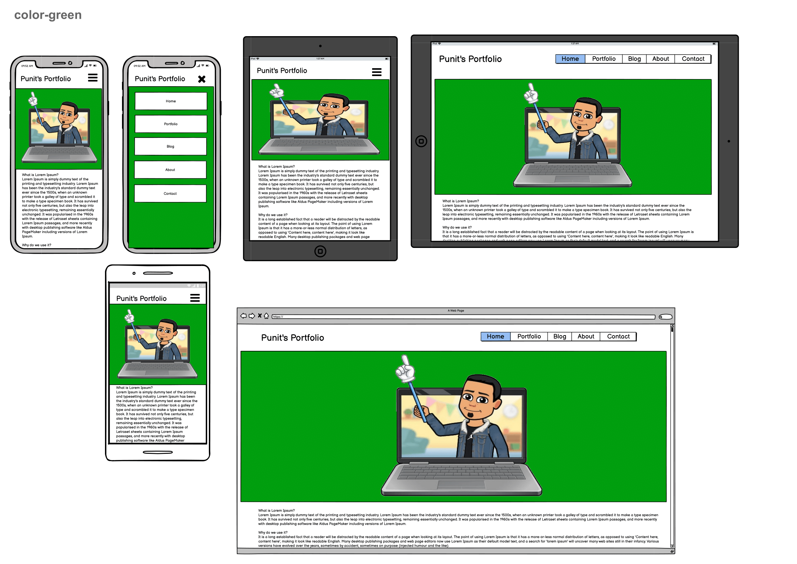
WireFrames – /Index.html

Slide 13
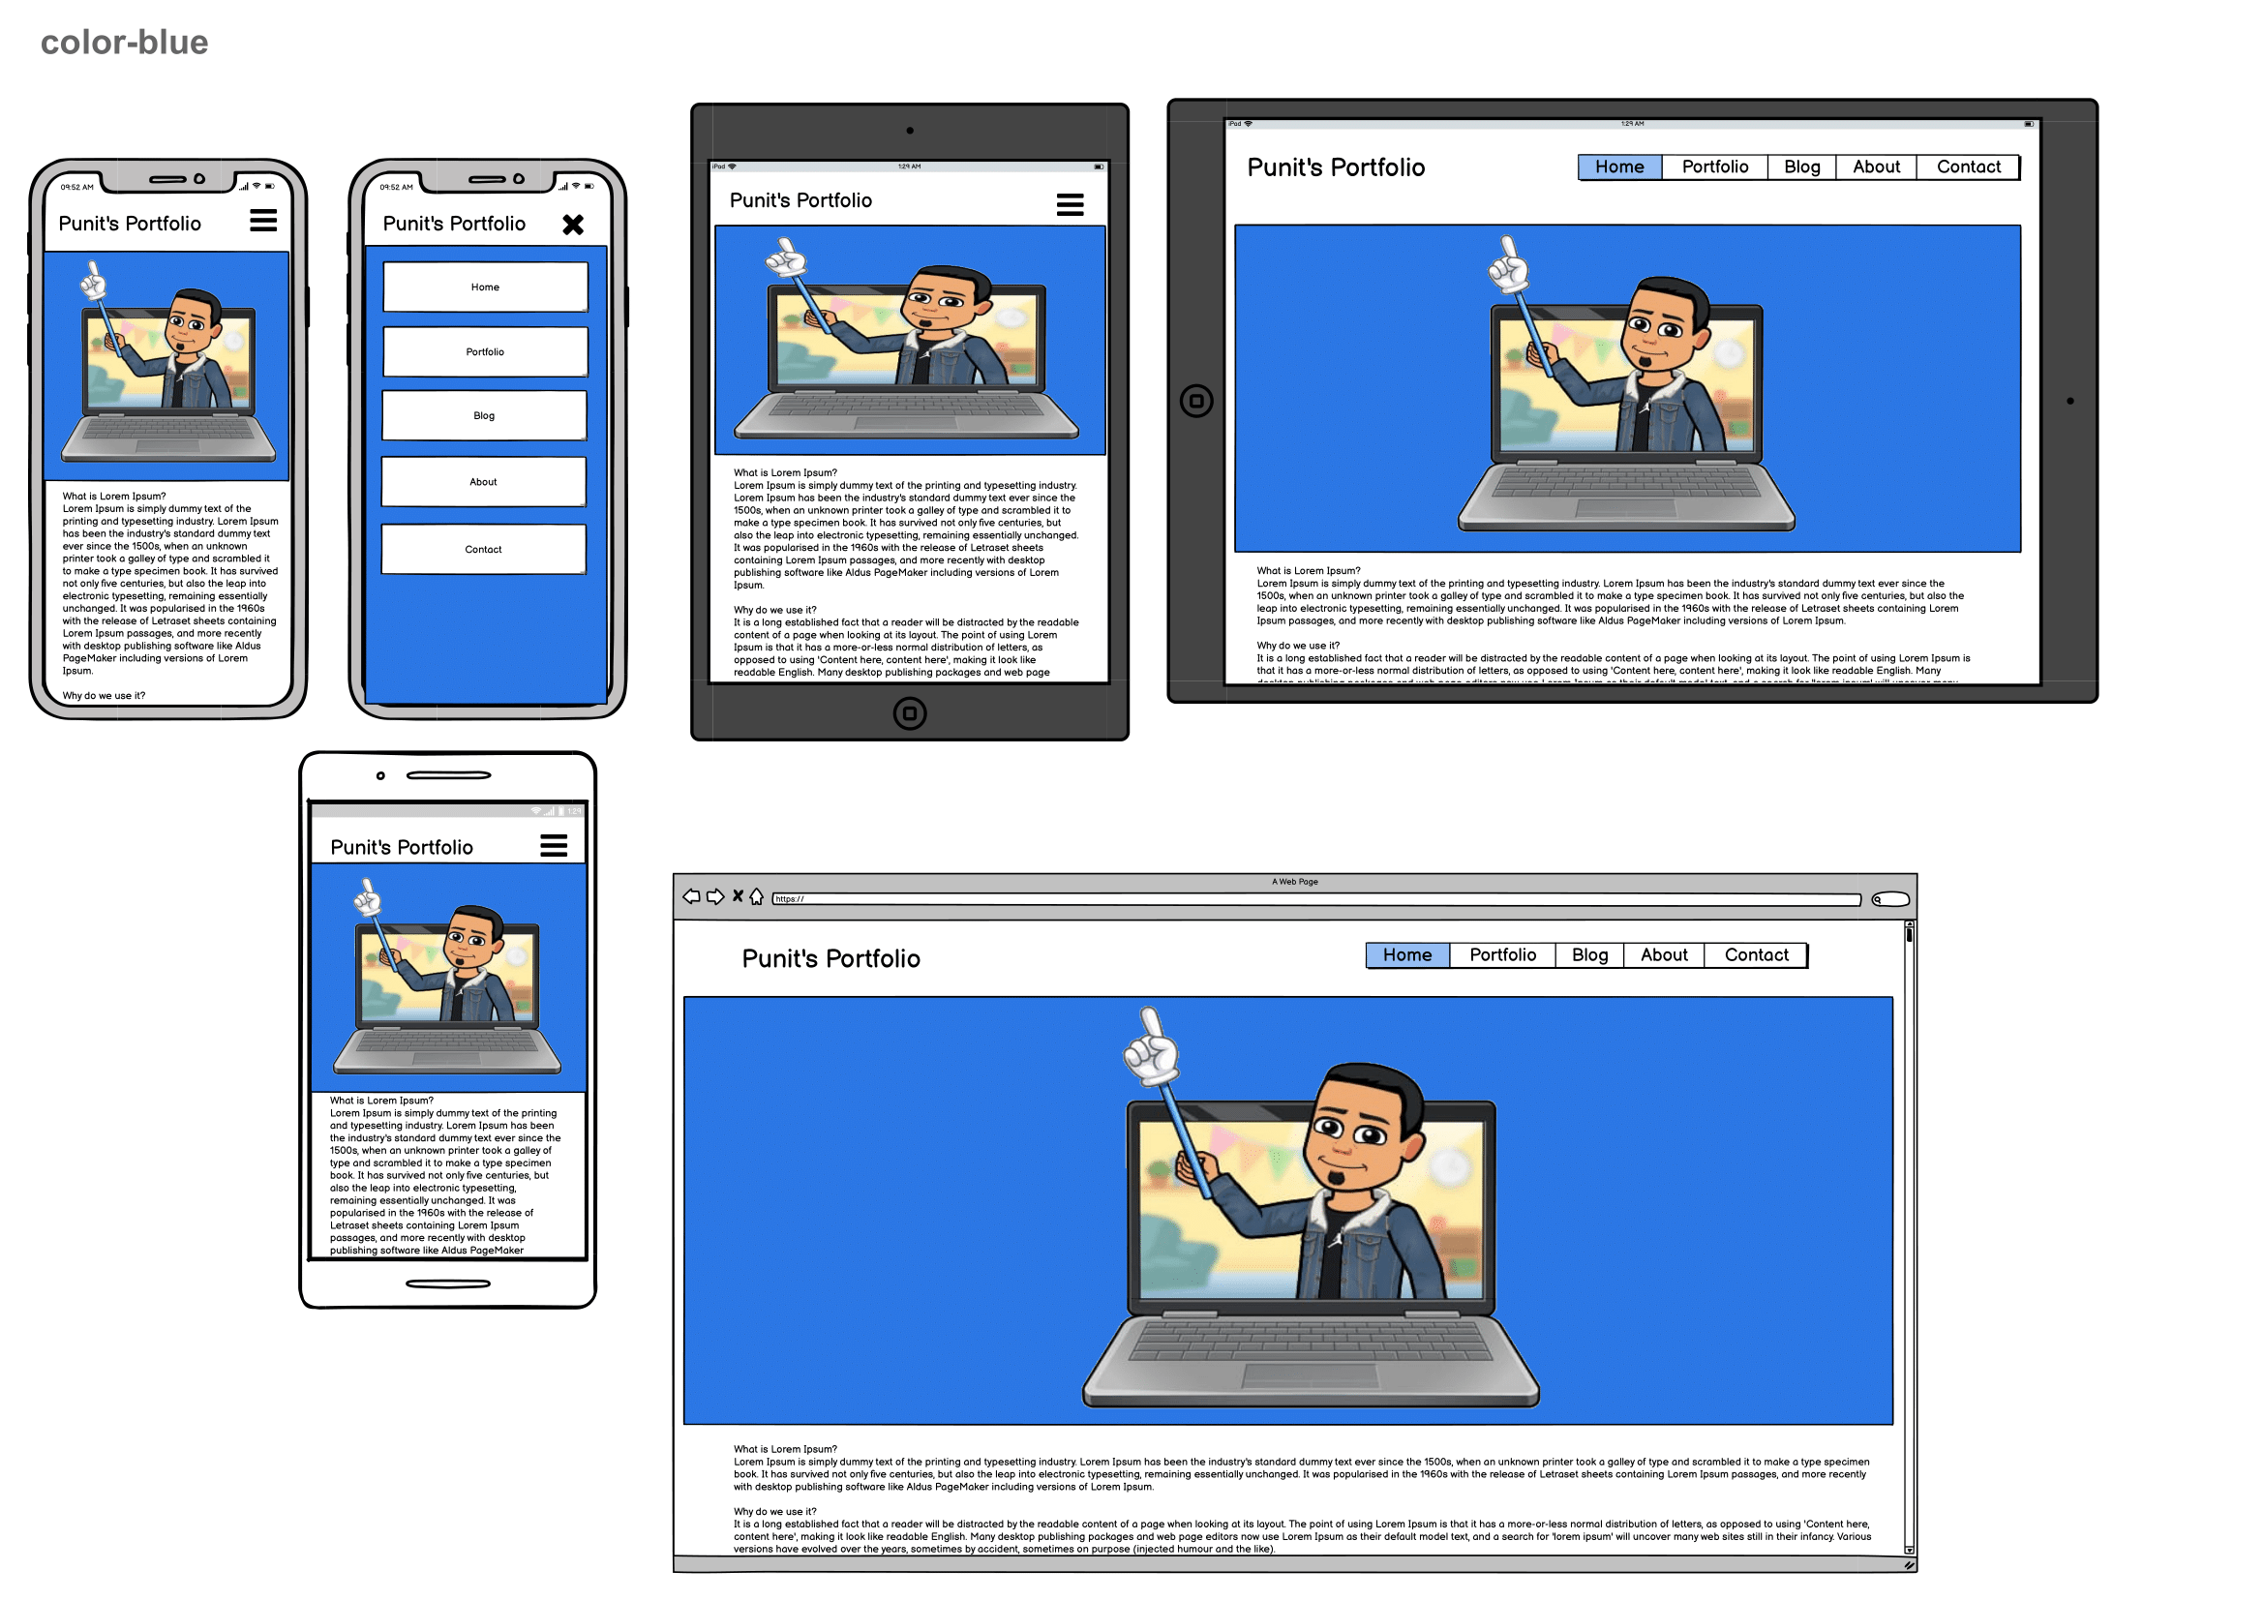
WireFrames – /Index.html

Slide 14
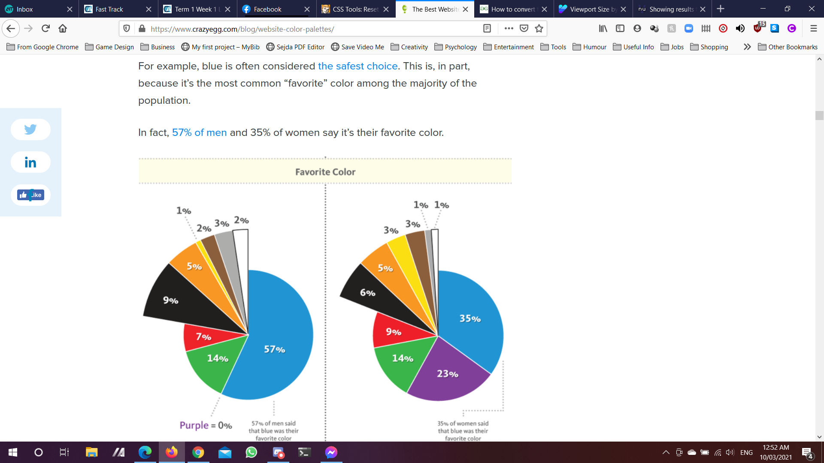
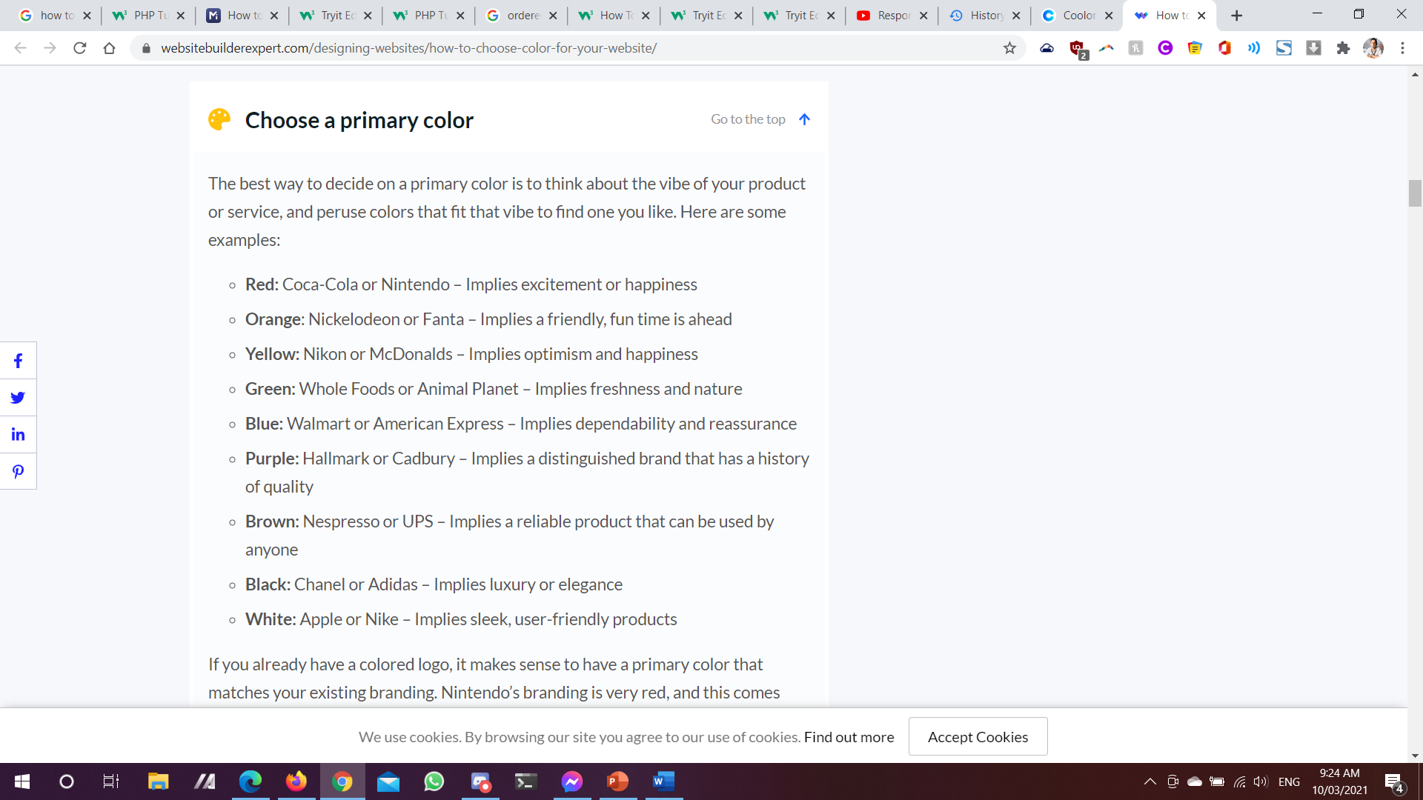
WireFrames – /Index.html

Slide 15
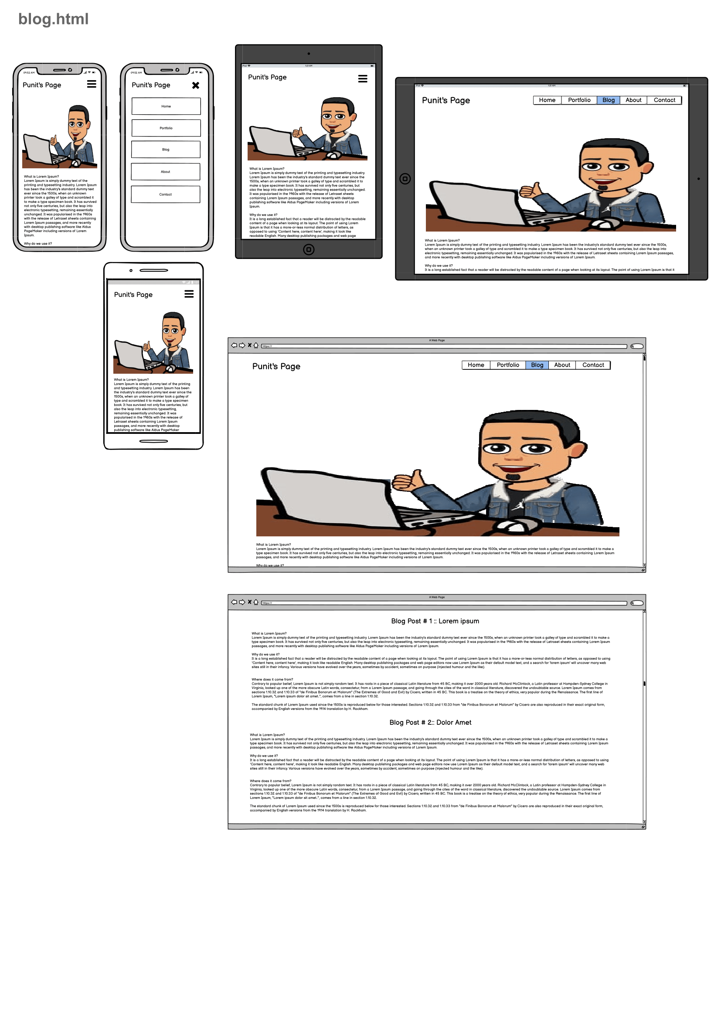
WireFrames – /Blog.html

Slide 16
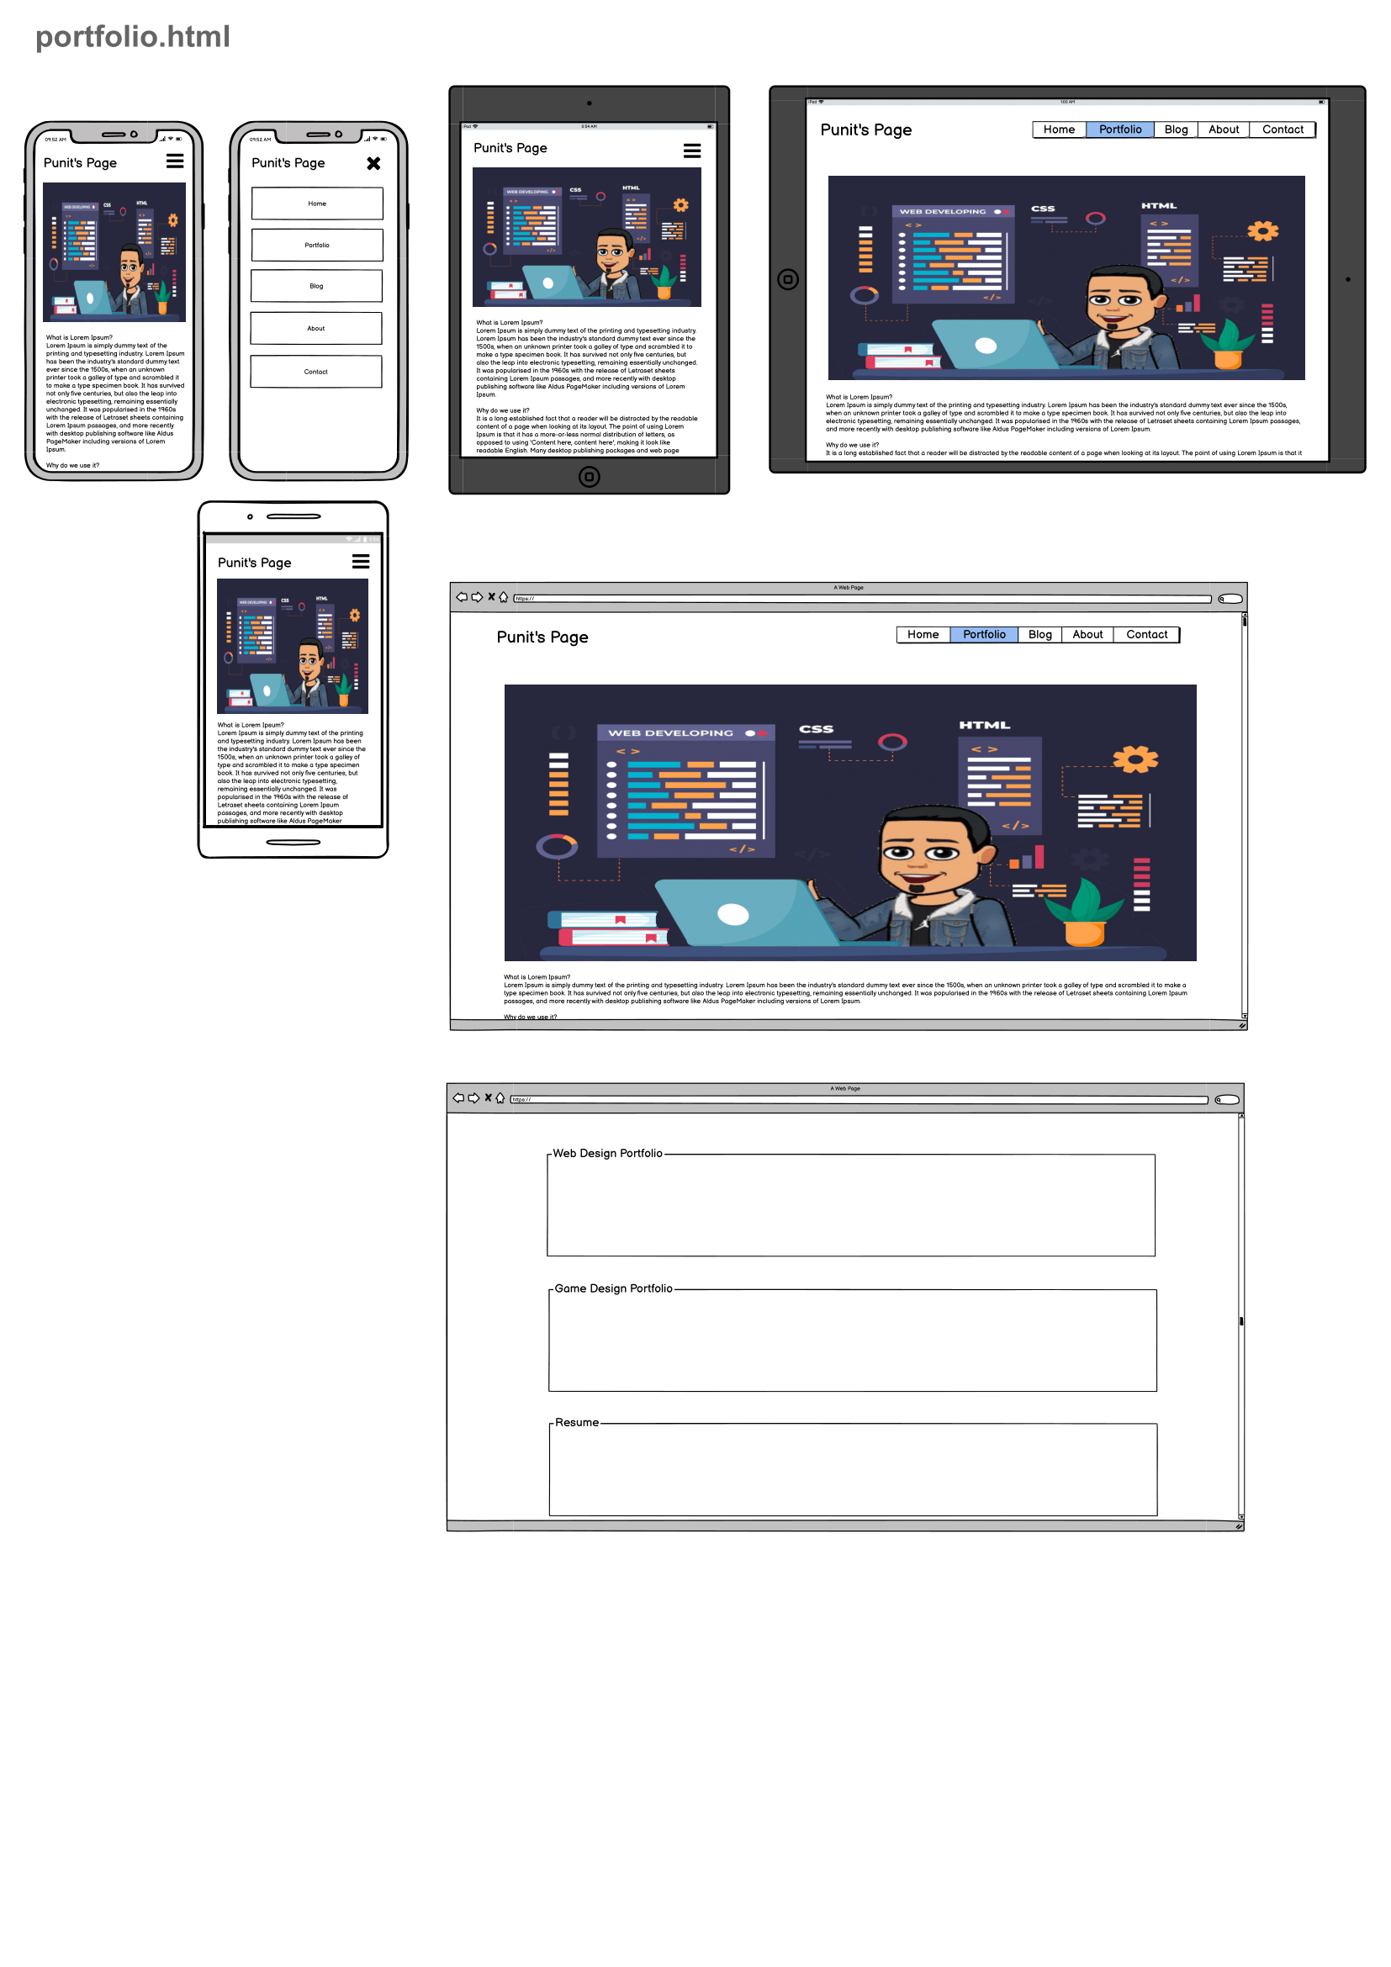
WireFrames – /Portfolio.html

Slide 17
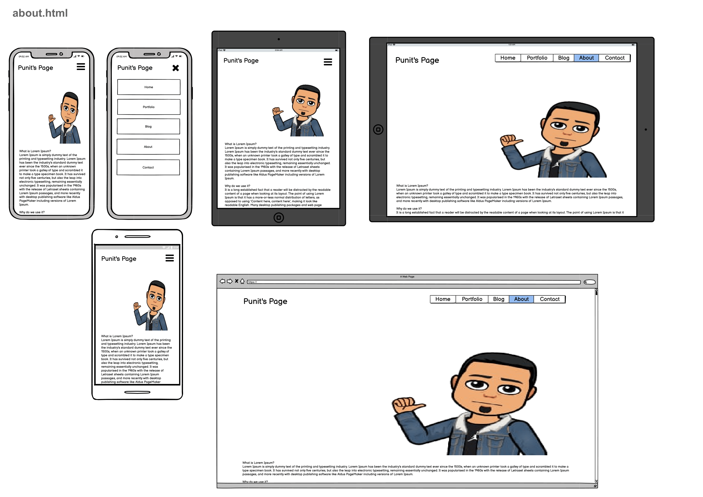
WireFrames – /About.html

Slide 18
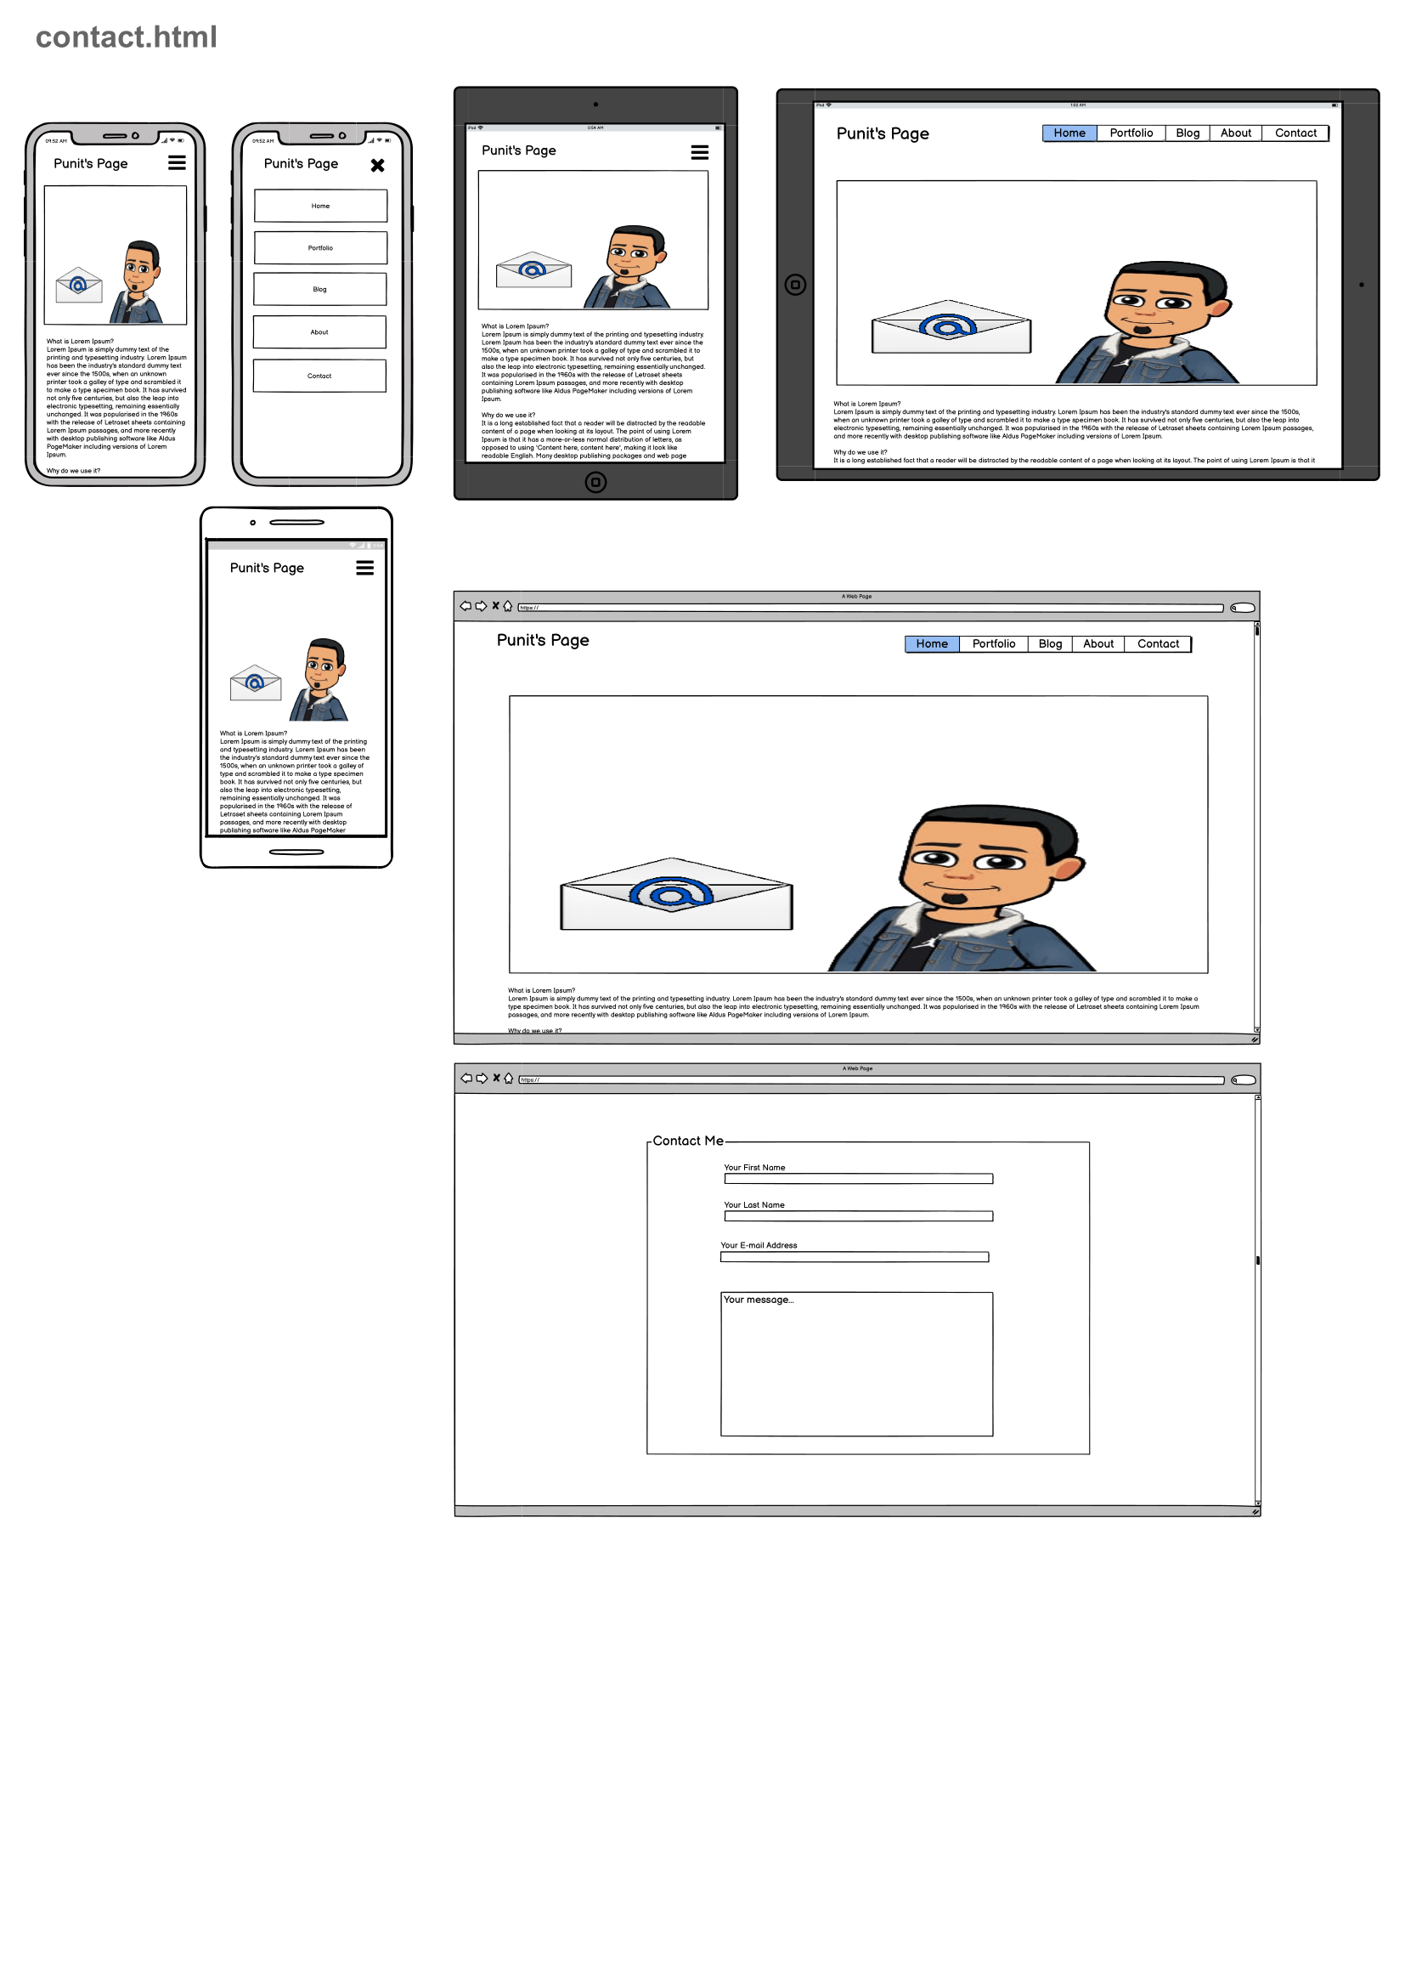
WireFrames – /Contact.html

Slide 19
Design Decisions
CSS Decisions

Slide 20
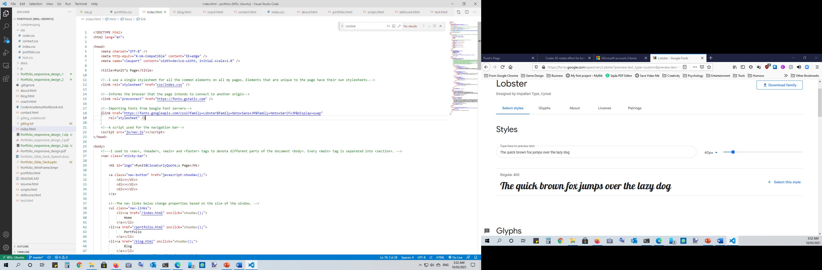
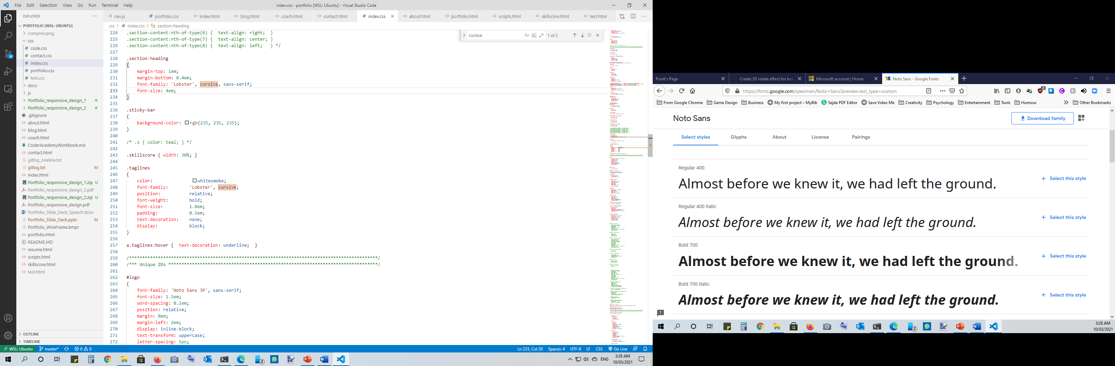
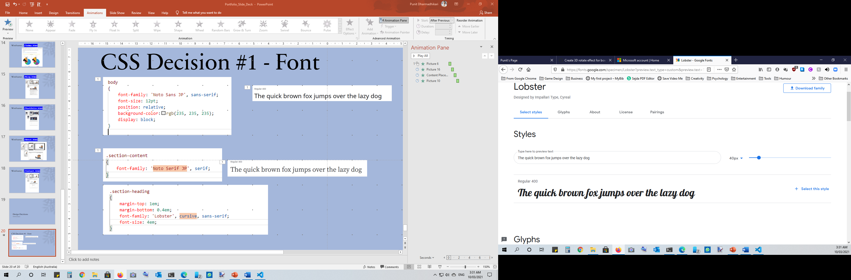
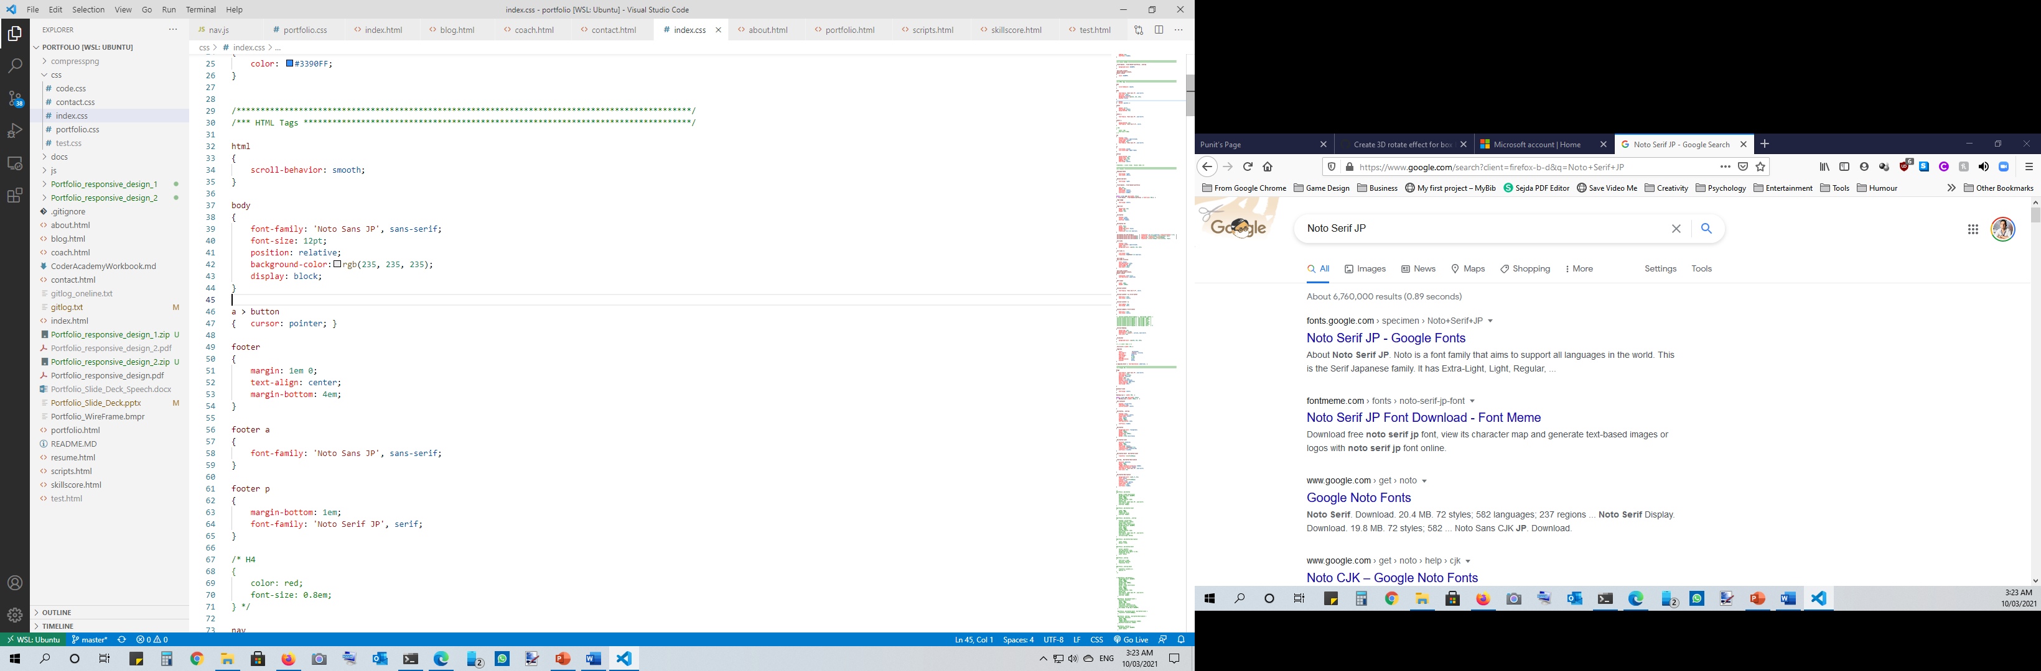
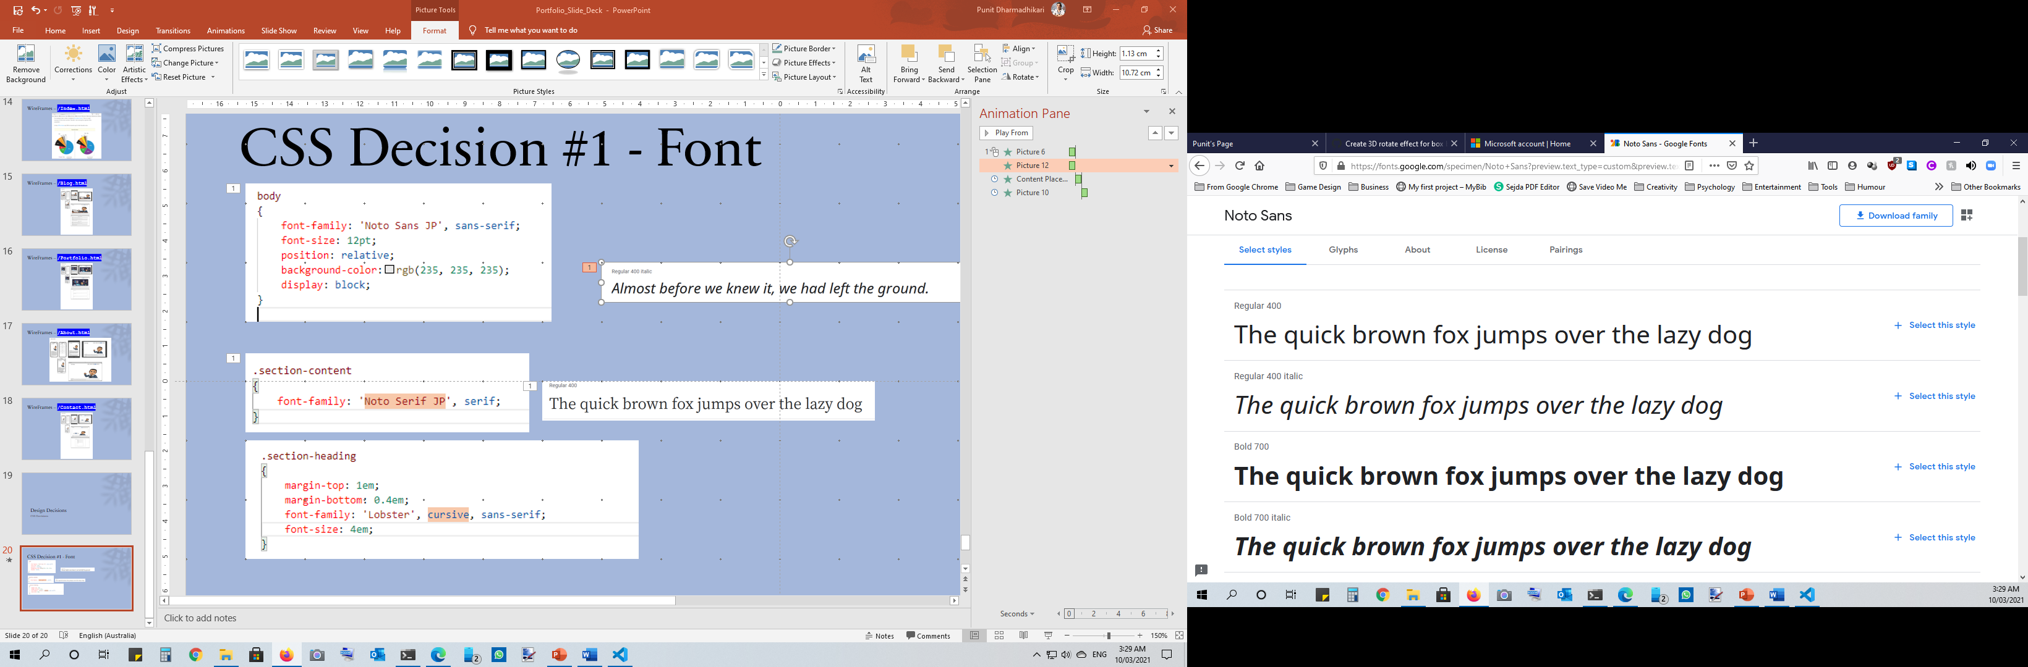
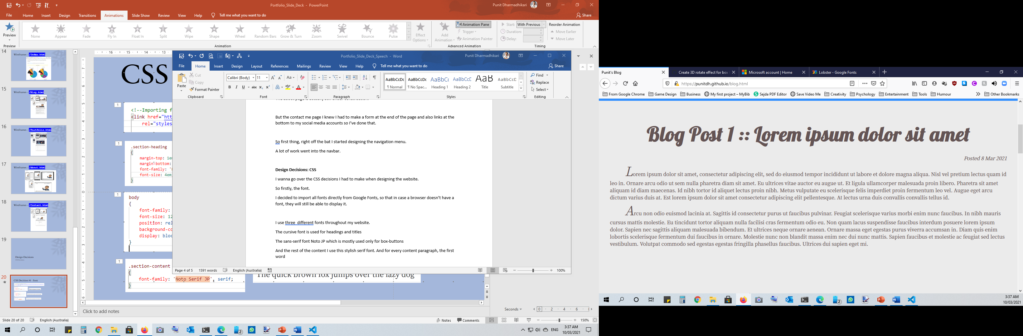

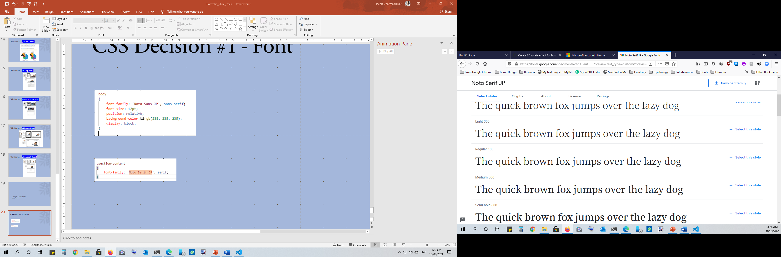
CSS Decision #1 - Font

Slide 21
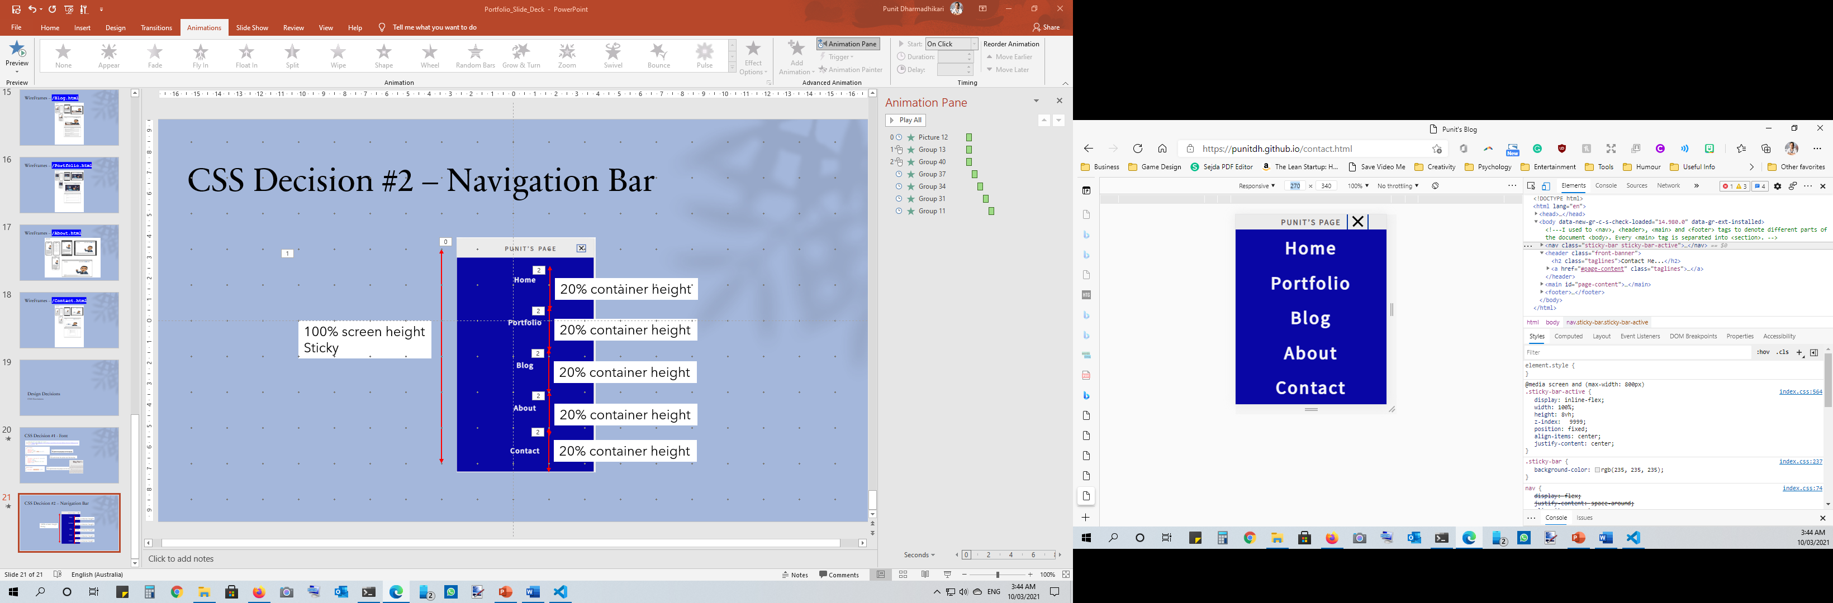
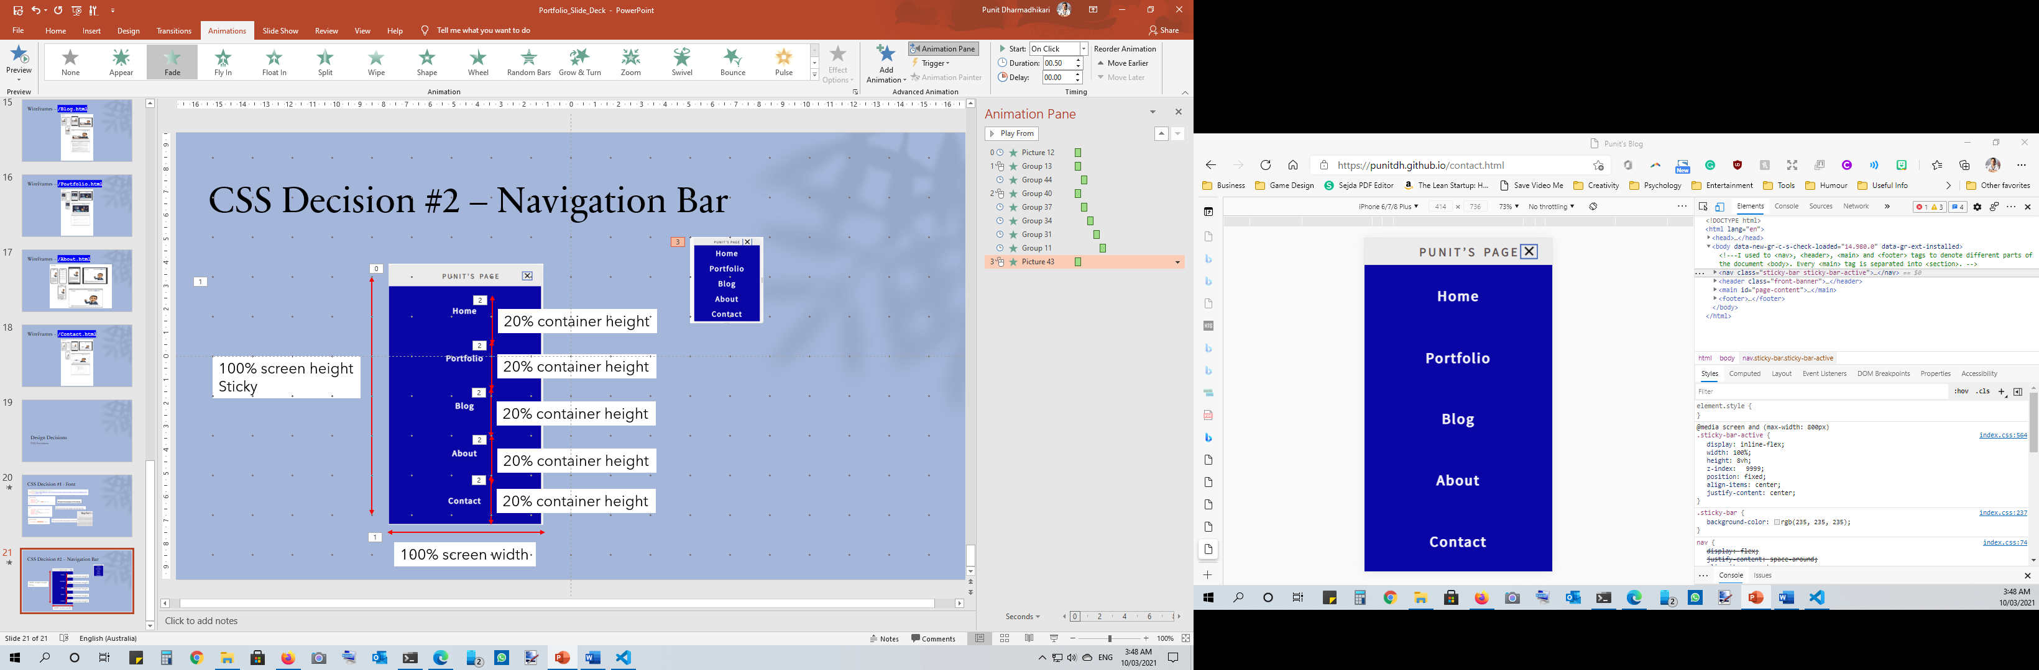
CSS Decision #2 – Navigation Bar
20% container height
100% screen height
Sticky
20% container height
20% container height
20% container height
20% container height
100% screen width

Slide 22
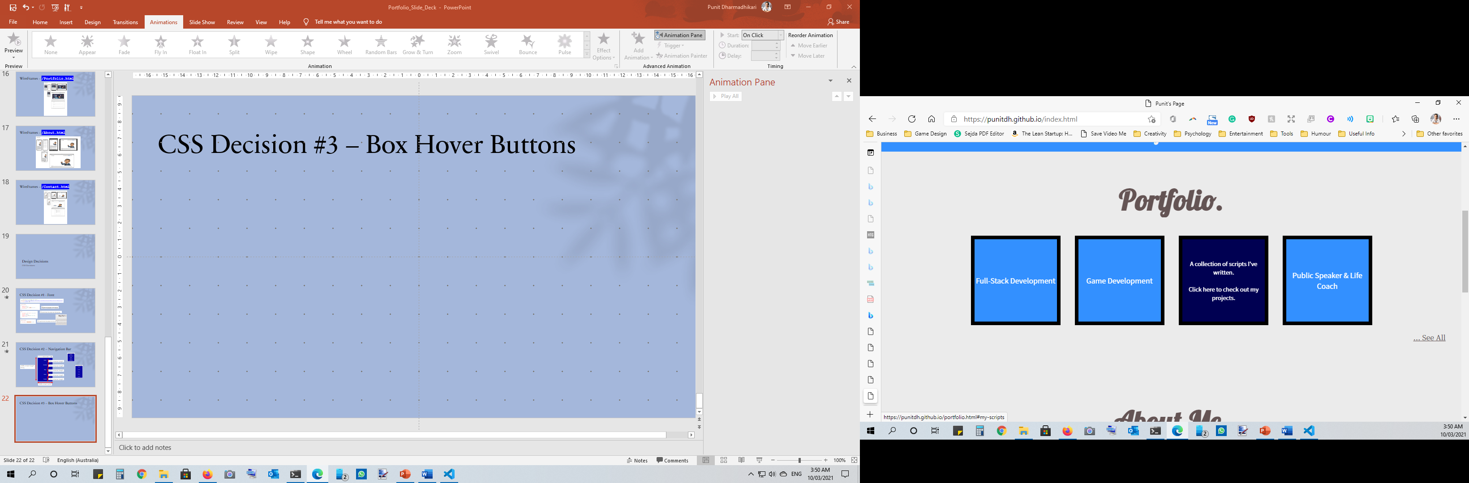
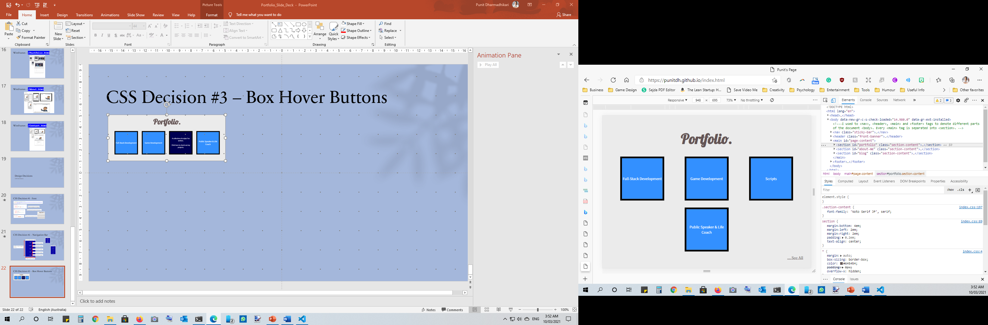
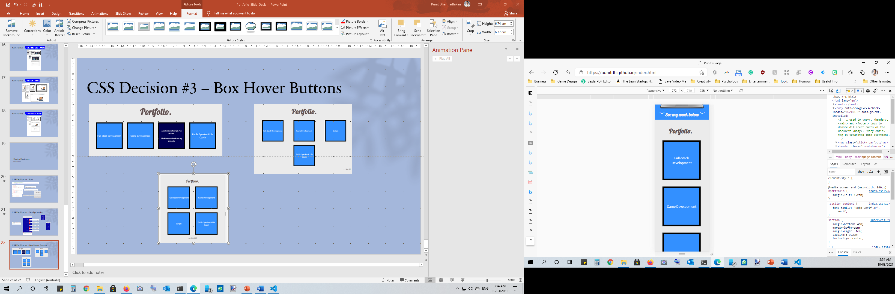
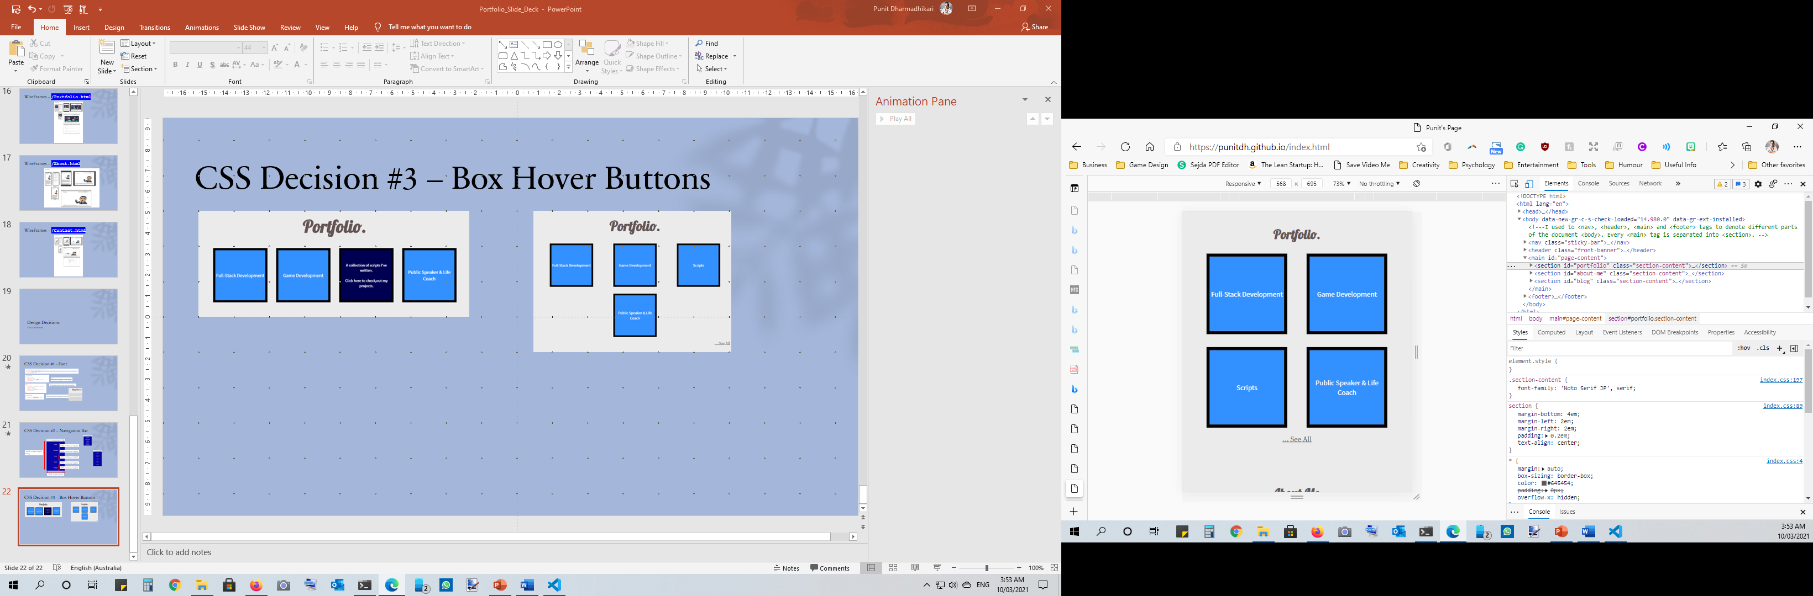
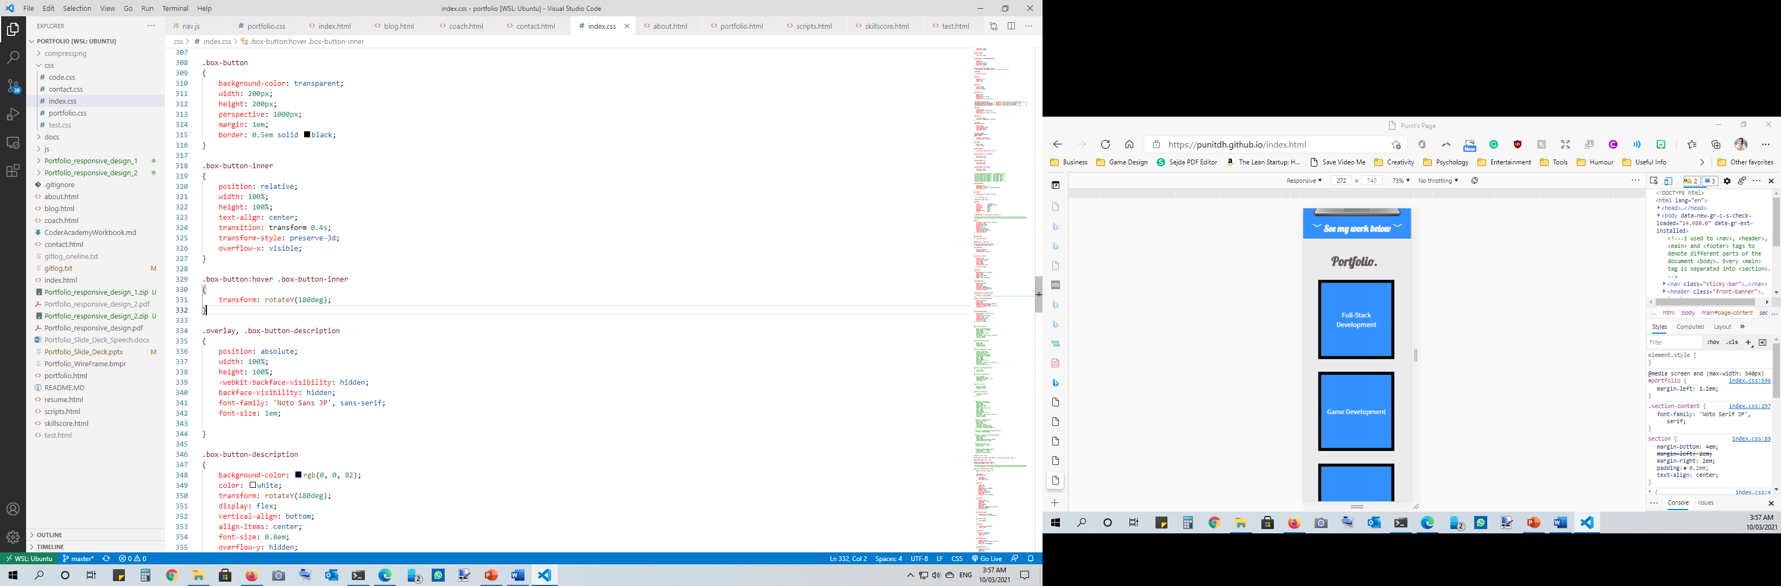
CSS Decision #3 – Box Hover Buttons

Slide 23
Favourite Part…

Slide 24

Thank You!
- Punit Dharmadhikari

